Slide 1
Accessibility in official statistics
RSS International Conference, Edinburgh
04/09/2025

Slide 2
Agenda
Introduction, why should you care about accessibility? – Clare Griffiths
On-brand accessibility for memorable graphs – Cara Thompson
afcharts – Olivia Box Power
Interactivity in charting – Nicola Rennie
Accessibility in action using Power BI – Elliot Bridges
Question and Answer session

Slide 3
PSBA Quote
Public sector bodies must comply with the accessibility requirement, where ‘accessibility requirement’ means the requirement to make a website or mobile application accessible by making it perceivable, operable, understandable and robust.
Public Sector Bodies Accessibility Regulations 2018

Slide 4
Public bodies had until September 2020 to meet this requirement!

Slide 5
Why does it matter?
It is now September 2025! We’ve had 5 years to get this right…
It is crucial that the data visualisations we produce are understood by people of all abilities
1 in 12 men and 1 in 200 women have some form of colour blindness
Inaccessible data visualisations risk misinterpretation
Meeting WCAG standards future proofs content
Legal obligations as mentioned

Slide 6

A game… Descriptionary
With thanks to colleagues in DfT
Notes:
I will give you a description, you have to draw what I am telling you and we’ll see how close you get!

Slide 7
Round 1 – warm up
Description: A pear and a bunch of grapes in a bowl

Slide 8

Description: A pear and a bunch of grapes in a bowl

Slide 9
Round 2
Description: a chart showing the proportion of short commute journeys, between 2002 and 2021, in Great Britain

Slide 10
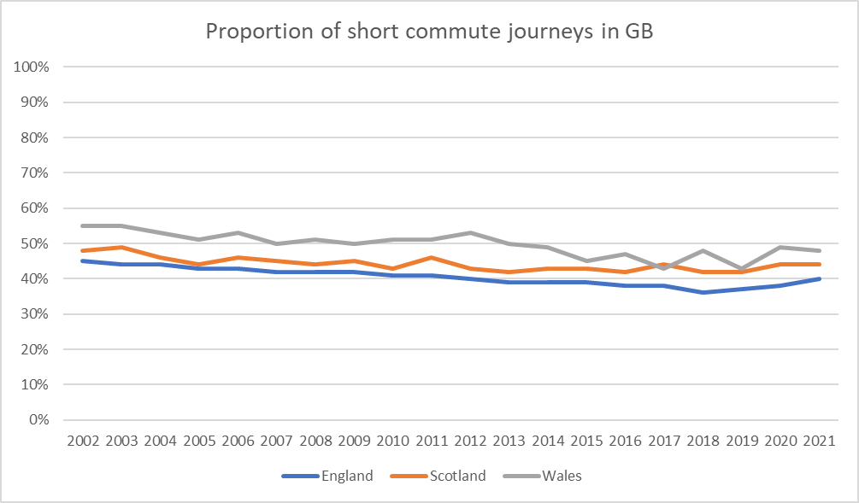
Description: a chart showing the proportion of short commute journeys, between 2002 and 2021, in Great Britain

Slide 11
Round 3
Description: Figure 1 is a bar chart showing the top 5 reasons for travel in 2021 in England. The most common reason for travel is leisure with 221 trips per person. It’s then followed by 151 trips for shopping, 119 for commuting, 118 for education and 92 for other reasons including walks.

Slide 12
Figure 1: Average number of trips completed per person, by purpose, in England, 2021
Description: Figure 1 is a bar chart showing the top 5 reason for travel in 2021 in England. The most common reason for travel is leisure with 221 trips per person. It’s then followed by 151 trips for shopping, 119 for commuting, 118 for education and 92 for other reasons including walks.

Slide 13
Hopefully I’ve persuaded you accessibility matters…
So what can you do about it?
Understanding accessibility requirements for public sector bodies - GOV.UK
Additional guidance and tools – analysis function guidance, afcharts, aftables
Talk to colleagues – government digital and data science slack channels, Basecamp
This session!

