Slide 1



Visualising the UK’s LGBTQ+ population
Kirstie Ken English (they/them)
Nicola Rennie (she/her)
#VisLGBTQ

Slide 2
Content
Introductions & Gender + Sexuality Data Lab
Census 101
LGBTQ+ people and the UK censuses
Question designs
The guidance debate
Text data
Note on non-response rates
Visualizing the LGBTQ+ populating using census data

Slide 3
Share your vislulisations on Bluesky or Linkedin
via #VisLGBTQ
INTRODUCTION
Kirstie Ken English
@kenglish.bsky.social
kirstie.ken.english@glasgow.ac.uk
Website
Nicola Rennie
@nrennie.bsky.social
nrennie.research@gmail.com
Website

Slide 4
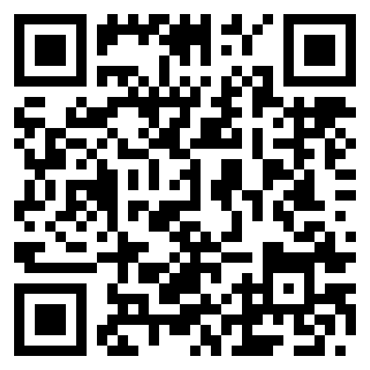
Gender + SexualIty Data Lab
University of Edinburgh
Directed by Dr Kevin Guyan
Brings together people engaged in critical work surrounding the collection, analysis and use of sex, gender and sexuality data.

Slide 5
3 UK censuses:
England and Wales: Office of National Statistics(ONS)
Northern Ireland: Northern Ireland Statistics and Research Agency(NISRA)
Scotland: National Records Scotland(NRS)
Ran every 10 years since 1801, apart from:
During World War 2
When there was a 5 year census
Due to COVID-19 Scotland delayed their census by 1 year meaning it ran in 2022.
The Census Act 1920 provides the legal mandate for everyone to participate in the census. If you don’t submit a census form you can be fined £1,000.
Census 101

Slide 6



Household survey
Usually around March
Online first 2021/2022
Individual forms can be requested
Paper forms could be requested
How they work

Slide 7
LGBTQ+ people and the UK censuses
The 2021 censuses were the first in the world to feature sexual orientation questions
The 2021/22 censuses were the first to feature questions on how many trans people there are in the UK
There was considerable debate including legal cases over how sex should be understood in the 2021/22 censues

Slide 8

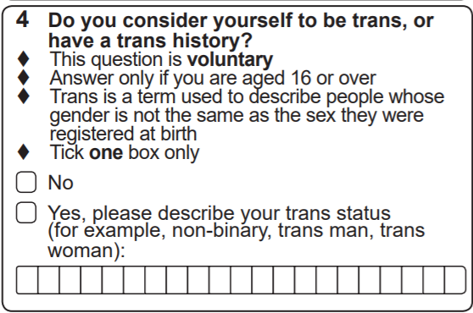
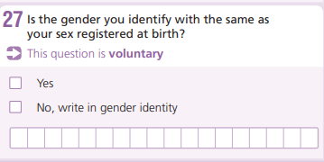

Slide 9
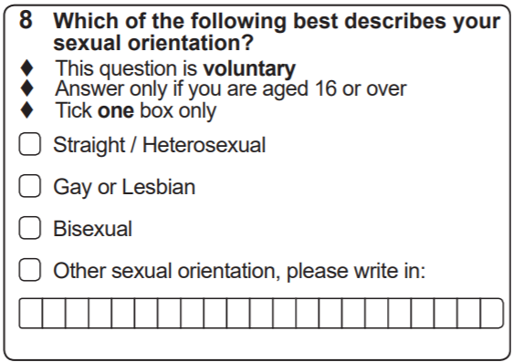

Slide 10
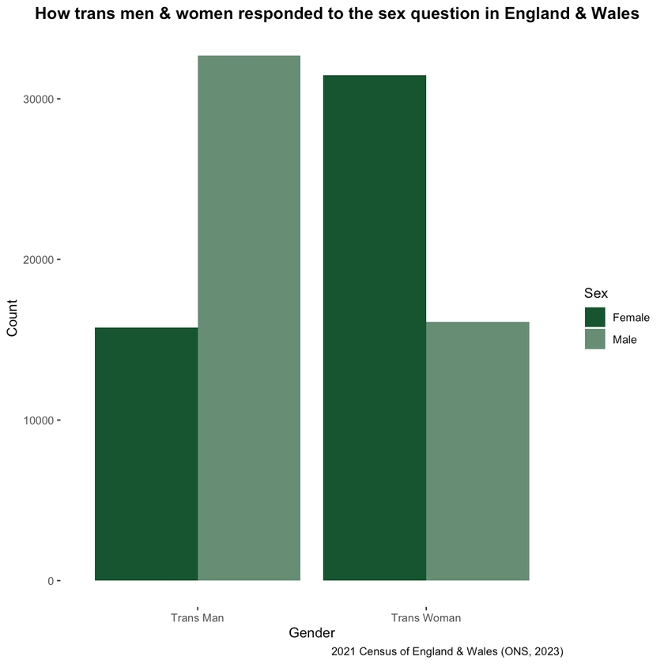
The sex guIdance debate
Lived sex = trans people respond based on how they live
Documented sex = trans people with GRC’s respond based on how they live
Timeline:
2001: It was recognised that it was unclear how trans people should respond to the sex question. Those that asked were provided lived sex guidance
2011: Live sex guidance utilised across UK census online help pages
2021/22: Split in guidance use

Slide 11
The 2021/2022 UK census designs
Census | Gender modality | Sexual orientation | Sex question with lived sex guidance | Sex question with documented sex guidance
Scotland (2022) | x | x | x
England and Wales (2021) | x | x |  | x
Northern Ireland (2021) |  | x |  | x
Notes:
9

Slide 12
Lack of clarIty or detail surrounding text based data
We can’t access the text data
We don’t have estimates of most common text responses
It is unclear how text data was coded. This means we can’t tell who is and is not included in the population counts.
If I wrote I was “agender and non-binary” in response to the gender modality question would they:
Count me as non-binary
Count me as agender
Count me as “other”
It is unclear if the approach to this differs across the three UK censuses

Slide 13
Non-response rates
Question | Census | Non-response rate (%)
Gender modality | Scotland | 5.92
Gender modality | England and Wales | 6
Sexual orientation | Scotland | 8.2
Sexual orientation | England and Wales | 7.5
Sexual orientation | Northern Ireland | 7.9

